Slide 1
Topic: Systematic approach to factor Investing in Stock Market
REVA Academy for Corporate Excellence (RACE)
Date:21/5/2021
Name of the Presenter(s)
Anand Mohan
Batch:MBA06
Trimester: THIRD TRIMESTER
SRN: R19MBA53
www.race.reva.edu.in

Slide 2
Background Information
What are the main categories of risk we should be concerned about when making any financial investment?
Systematic & Unsystematic risk
Inflation risk
Sentiment risk
Interest Rate risk
Credit risk
Currency risk
Liquidity risk
Event risk
Political risk
Operational risk
Relative risk
Gearing risk
Non-diversification risk

Slide 3
Statement of the Problem
Maximizing Returns:
As an investor you want to maximize the returns for a given level of risk. The relationship between the returns for the different assets in the portfolio is important. A good portfolio is not simply a collection of individually good investments.
Risk Aversion:
Given a choice between two assets with equal rates of return, most investors will select the asset with the lower level of risk. Risk aversion is a consequence of decreasing marginal utility of consumption.
In a nutshell we can conclude that modern investors want maximum returns and minimal risks. Having defined the problem statement we will explore various possibilities starting with Markowitz Portfolio Theory and then moving on to CAPM and then to arbitrage-pricing-theory and then finally arrive at multi factor investments as the most latest paradigm applied in stock market portfolios formulations.

Slide 4
Statement of the Problem
Assumptions of Markowitz Portfolio Theory:
Investors consider each investment alternative as being presented by a probability distribution of expected returns over some holding period.
2. Investors minimize one-period expected utility, and their utility curves demonstrate diminishing marginal utility of wealth.I.e., investors like higher returns, but they are risk-averse in seeking those returns And, again, this is a one-period model (i.e., the portfolio will need to be rebalanced at some point in the future in order to remain optimal).
3. Investors estimate the risk of the portfolio on the basis of the variability of expected returns. I.e., out of all the possible measures, variance is the key measure of risk

Slide 5
Statement of the Problem
Assumptions of Markowitz Portfolio Theory:
4. Investors base decisions solely on expected return and risk, so their utility curves are a function of only expected portfolio returns and the expected variance (or standard deviation) of portfolio returns.
Investors’ utility curves are functions of only expected return and the variance (or standard deviation) of returns. Stocks’ returns are normally distributed or follow some other distribution that is fully described by mean and variance.
5. For a given risk level, investors prefer higher returns to lower returns. Similarly, for a given level of expected returns, investors prefer less risk to more risk.
Using these five assumptions, a single asset or portfolio of assets is considered to be efficient if no other asset or portfolio of assets offers higher expected return with the same (or lower) risk, or lower risk with the same (or higher) expected return.

Slide 6
Statement of the Problem
Systematic versus Idiosyncratic Risk:
An investment’s systematic risk is far more important than its unsystematic risk.
If the risk of an investment comes mainly from unsystematic risk, the investment will tend to have a low correlation with the returns of most of the other stocks in the portfolio, and will make a minor contribution to the portfolio’s overall risk.
Diversification and Systematic Risk:
Systematic or non-diversifiable risk is not reduced even as we increase the number of stocks in the portfolio.
Systematic sources of risk (such as inflation, war, interest rates) are common to most investments resulting in a perfect positive correlation and no diversification benefit.
Large portfolios will not be affected by unsystematic risk but will be influenced by systematic risk factors.

Slide 7
Statement of the Problem
Limitations of Markowitz portfolio optimization:
1.Too many inputs required
It Limit use to asset allocation or small-scale problems
2.Use of estimates can lead to “error maximization”
It Introduce additional “hard” constraints in optimization process.we need to Use “portfolio resampling” to find average optimal portfolio given range of possible estimates.
3.Reliance on historical data to obtain estimates
True parameters not only never known, but also not constant over time.

Slide 8
Statement of the Problem
Systematic Risk and Beta:
Systematic risk is measured by beta coefficient, which estimates the extent to which a particular investment’s returns vary with the returns on the market portfolio.
The CAPM:
CAPM also describes how the betas relate to the expected rates of return that investors require on their investments.
The key insight of CAPM is that investors will require a higher rate of return on investments with higher betas. The relation is given by the following linear equation:
R_{market} is the expected return on the market portfolio
R_{f} is the risk free rate (return for zero-beta assets).

Slide 9
Statement of the Problem
Difference between CAPM and Arbitrage Pricing Theory::
In the CAPM theory, the expected return on a stock can be described by the movement of that stock relative to the rest of the market. The CAPM is really just a simplified version of the APT, whereby the only factor considered is the risk of a particular stock relative to the rest of the market, as described by the stock's beta.
The problem with this is that the theory in itself provides no indication of what these factors are, so they need to be empirically determined. Obvious factors include economic growth and interest rates. For companies in some sectors other factors are obviously relevant as well - such as consumer spending for retailers.
The potentially large number of factors means more betas to be calculated. There is also no guarantee that all the relevant factors have been identified. This added complexity is the reason arbitrage pricing theory is far less widely used than CAPM.

Slide 10
Proposed Solution
A new approach has recently emerged in investment practice known as Multi factor investing, which recommends that allocation decisions be expressed in terms of risk factors, as opposed to standard asset class decompositions.
Factors have historically been identified as critical drivers of portfolio risk and return and can now be used to better inform the investment process.
Factors may help investors meet their objectives such as reducing risk, increasing returns, and increasing diversification by providing a better understanding of risk and returns.

Slide 11
Proposed Solution
We will apply fewer Modeling Approaches to arrive at some Actionable Insights for profit which may be following:
1.principal component analysis:
We will find subset of variables that are the essential ones within the higher set of variables, and there's a method in statistics called principal component analysis. It is a method that allows to take a high dimensional set of data, projected on to much lower dimensions and give us basic information about what's important and what's not important.
2.cluster analysis:
A second approach that we're going to use is what's called cluster analysis. We will find clusters that somehow have commonality that are relatively homogeneous among themselves. And we will separate the data into clusters where there's one group of companies that act very similarly, from another group that that acts in a different way.

Slide 12
Proposed Solution
We are going to combine the PCA and the clustering to give us information that we can use in our investment strategies.
3.Graphical analysis:
•Here we take a group of companies and we put them in a network where the connections are indicated through the arcs in the network, the lines that connect the points. And the location on the network tells us, how central that company is, relative to everyone else. So the graphical analysis tells us what's the relationship among companies and how central are they in terms of their influences on other companies and we're going to use this over time to identify patterns that we might find. The courses will change, we will see this graph moving across time, and that will give us additional information.
•We need to find ways to identify patterns in the data. And we want to do that through these three methods, the principal component analysis, the clustering, and the graphical analysis.

Slide 13
Proposed Solution
There are two main types of factors that have driven returns: macroeconomic factors, which capture broad risks across asset classes; and style factors, which help to explain returns and risk within asset classes.
Macroeconomic factors:
1. Economic growth: Exposure to the business cycle
2. Real rates: The risk of interest-rate movements
3. Inflation: Exposure to changes in prices
4. Credit: Default risk from lending to companies
5. Emerging markets: Political and sovereign risks
6. Liquidity: Holding illiquid assets

Slide 14
Proposed Solution
Style factors:
1. Value: Relatively inexpensive stocks. Captures excess returns to stocks that have low prices relative to their fundamental value
2. Low size (small cap): smaller companies. Captures excess returns of smaller firms (by market capitalization) relative to their larger counterparts
3. Momentum: rising stocks. Reflects excess returns to stocks with stronger past performance
4. Low volatility: lower risk stocks. Captures excess returns to stocks with lower than average volatility, beta, and/or idiosyncratic risk.

Slide 15
Proposed Solution
Style factors:
5. Dividend yield: cash flow paid out. Captures excess returns to stocks that have higher-than-average dividend yields
6. Quality: sound balance sheet stocks. Captures excess returns to stocks that are characterized by low debt, stable earnings growth, and other “quality” metrics
7. Growth: Measure of change in sales and earnings. Measures company growth prospects using historical earnings, sales and predicted earnings
8. Liquidity: Size-adjusted trading volume. Captures common variations in stock trading volumes relative to available shares trading.
The objective is to survey, study, and examine various facets and provide better solutions to overcome the challenges in Factor investing.
RP as Mentor and support from other Faculties as may be needed for more ideas and better implementation.

Slide 16
Detailed Scope of Work:
Conclusions:
There are 3 steps in our graphical network analysis algorithm:
First, we do sparse covariance estimation to find an estimate of the precision matrix. In our example, we use graphical lasso approach to accomplish this task.
Second, we perform clustering technique to group returns into clusters that have similar behaviors. The clustering method we chose to use in our example is the affinity propagation approach.
Lastly, we utilize manifold learning techniques to find an 2D embedding for visualizing the network graph. In particular, we chose to use the Multidimensional Scaling, or MDS, approach to do so.
We can consider applying this algorithm to various datasets to extract the conditional dependency structure of the data and draw inferences based on the given network graph.
The Road Ahead…………..
Further, we will also analyze and find about the different zones namely normal ,Transitional and Crash periods under which the Stock portfolios can be further segregated to maximize Returns and Minimize Risks. We will use appropriate Modeling algorithms accordingly to draw further inferences….

Slide 17
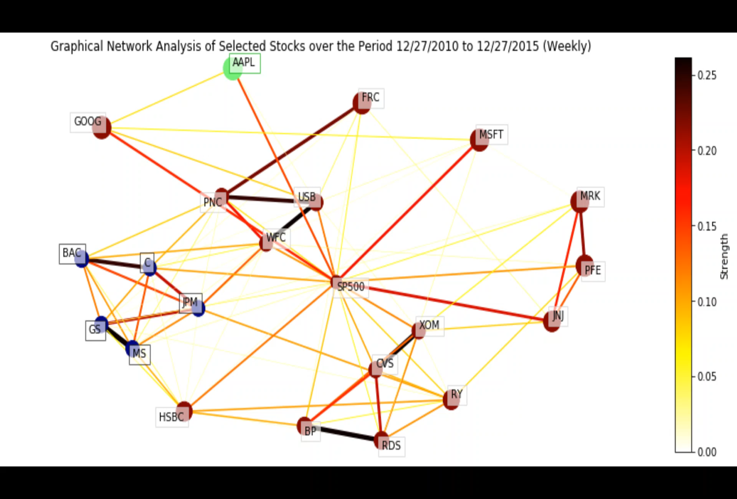
Detailed Scope of Work:
The data range is from Jan 2011 to June 2020, with 5-year rolling windows. Each frame is updated monthly (e.g. first frame is from Jan 2011 to Dec 2015, second frame is from Feb 2011 to Jan 2016.There are 55 frames (i.e. months) in total
Number of stocks included: 21 firms.
we simply re-run the graphical Analysis function for the various time frames (i.e. different start date and end date) to get the corresponding network graph.

Slide 18
References:
[1] Zelia Cazalet. and Thierry Roncalli (October 2014), Facts and Fantasies About Factor Investing
[2] David Blitz and Milan Vidojevic ,The Characteristics of Factor Investing
[3] Andrew Ang (06-10-2013), Chapter 14: Factor Investing
[4] An EDHEC-Risk Institute Publication (March 2020),Factor Investing in Liability-Driven and Goal-Based Investment Solutions
[5] Scott N. Pappas, CFA; Joel M. Dickson, Ph.D. (April 2015), Factor-based investing
[6] Douglas M. Grim, CFA; Scott N. Pappas, CFA; Ravi G. Tolani; Savas Kesidis (April 2017), Equity factor-based investing: A practitioner’s guide
[7] An EDHEC-Risk Institute Publication (September 2020), The EDHEC European ETF, Smart Beta and Factor Investing Survey
[8] An EDHEC-Risk Institute Publication (September 2018), The EDHEC European ETF and Smart Beta and FactorInvesting Survey 2018
[9] An EDHEC-Risk Institute Publication (September 2019), The EDHEC European ETF, Smart Beta and Factor Investing Survey 2019
[10] An EDHEC-Risk Institute Publication (February 2018), Smart Beta and Beyond: Maximizing the Benefits ofFactor Investing
[11] EUGENE PODKAMINER (SUMMER 2015 Volume 24 Number 2), The Education of Beta: Can Alternative Indexes Make Your Portfolio Smarter?

Slide 19


